Slide 1
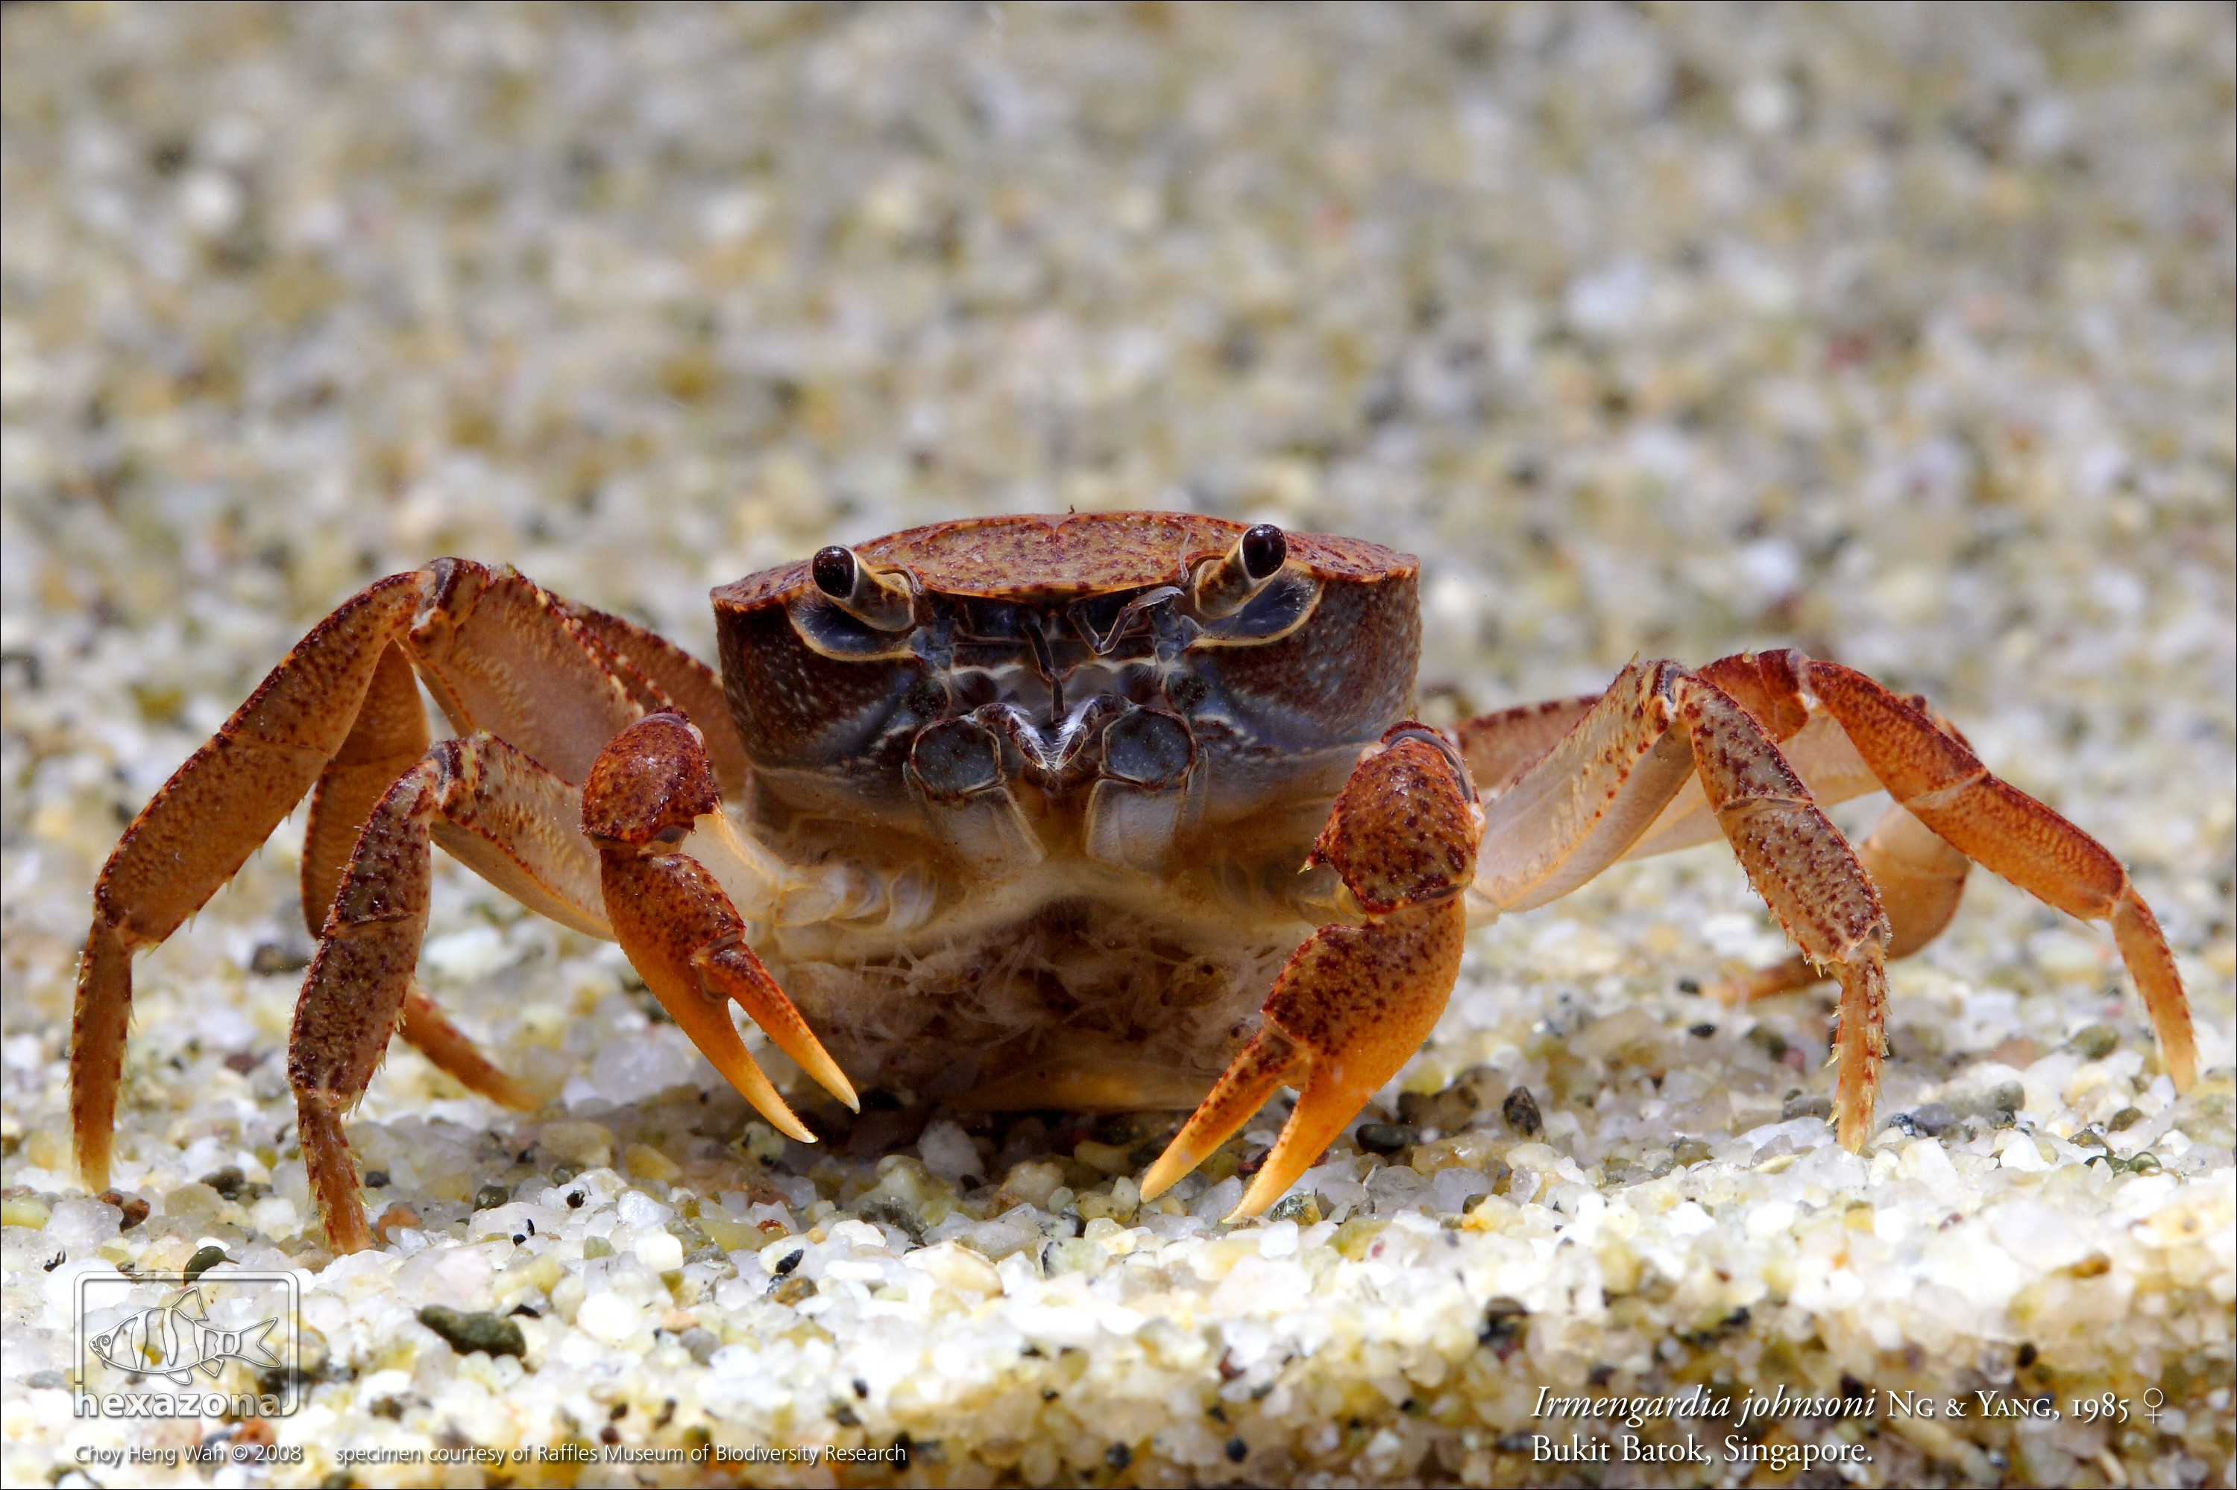
Freshwater Crabs and biodiversity crises

Slide 2
INTRODUCTION

Slide 3
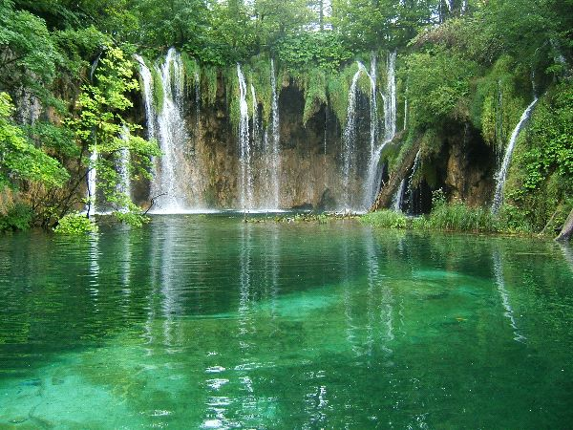
Globally, >1 000 000 spp rely on tropical freshwater ecosystems for survival.
References:
- Fresh water biome facts and information, bioexpedition.com, BioExpedtion
Notes:
3

Slide 4

2. Methods
Application of the International Union for Conservation of Nature (IUCN)
Conservation Assessments using the IUCN (2001) Red list Categories and Criteria (version 3.1)
Species Information system data provided by IUCN.
Assessment was done in 5 continents (43 countries)
- America, Africa, Asia, Europe and Australia

Slide 5
Analysis of species-level data
Conducted at Northern Michigan University as part of the Red List Index based on:
Taxonomy, distribution, population trends, ecology, life history, past and present threats and conservation actions
Identification of countries with
Most threatened species
Highest species diversity
Highest endemism rates
Numbers of threatened species correlated by
Family
region

